Slide 1
Tasks, async/await and multithreading
David Omid

Slide 2
What we’ll be covering…
CPU-bound vs I/O-bound operations
Synchronous vs asynchronous operations
Task, Task<T>, Thread and ThreadPool classes in C#
async and await
Optimising performance, scalability and throughput
Mixing CPU-bound and I/O-bound code in the same method
Dealing with exceptions
async void
Writing “fire-and-forget” background tasks
SynchronizationContext, deadlocks and ConfigureAwait
Etiquette when writing methods

Slide 3
CPU-bound vs I/O-bound operations

Slide 4
In simple terms…
Operations are CPU-bound when the speed of the operation is limited by the speed of the CPU. Speed can be increased by scaling up to a more powerful CPU, or somehow parallelising the operation using multiple threads.
Operations are I/O-bound when the speed of the operation is limited by the speed of input/output operations being completed. i.e. anything not done by the CPU, e.g. disk reads/writes, network requests, etc. Using more threads or improving the CPU does not make these operations faster.

Slide 5
Synchronous vs asynchronous operations

Slide 6
In simple terms…
When you execute something synchronously, you have to wait for it to finish before moving onto something else. During this time, you can’t do anything else. Your time waiting is essentially wasted.
When you execute something asynchronously, you can move onto another task before the first one finishes. You aren’t wasting any time just waiting around. You can get more work done during that time.
Doing things asynchronously can improve performance, scalability, throughput and efficiency

Slide 7
In terms of CPU and I/O operations…
If you want to execute CPU-bound operations asynchronously, you need to use multiple threads as each thread can only execute one thing at a time.
If you want to execute I/O-bound operations asynchronously, you shouldn’t use multiple threads as they aren’t used for these types of operations and will just be wasted.

Slide 8
When things should be asynchronous
You should write asynchronous code if:
You’re doing any form of I/O operations at all
You have a long-running CPU-bound operation which can be parallelised and you have no issue with using multiple threads. For web applications this is a bad idea though, for reasons we’ll go into later.
So how do you write asynchronous code in C#?

Slide 9
Task, Task<T>, Thread and ThreadPool classes in C#

Slide 10
Thread
Represents an actual OS-level thread, with its own stack and kernel resources.
Allows the highest degree of control; you can Abort(), Suspend(), or Resume() a thread. You can also observe its state and set its properties such as its stack size.
The problem is that OS threads are costly. Each thread uses a lot of memory for its stack and adds additional CPU overhead as the processor context-switches between threads.
It’s considered good practice to only have a small pool of threads which are reused and execute code as work becomes available.

Slide 11
ThreadPool
Acts as a wrapper around a pool of threads maintained by the CLR.
Gives you no control at all. You can submit work to be completed but you can’t even determine when the pool will start the work or when it’s completed it. You also can’t determine the result.
Using ThreadPool avoids the overhead of creating too many threads.
Submitting too many long-running tasks to the thread pool is bad however, as it can get full and later work that it submitted can end up waiting a long time for earlier submitted tasks to finish.

Slide 12
Task and Task<TResult>
Task represents an “awaitable” piece of work to be completed. Task<TResult> represents one which returns a value once it’s completed.
Tasks are executed by a TaskScheduler. The default scheduler runs on the ThreadPool. Threads are not created by tasks themselves.
Tasks can be run either synchronously or asynchronously.
The async and await keywords can be used with tasks.
A Task represents a single operation which can be run asynchronously, but might be run synchronously instead

Slide 13
Summary
Tasks are an easy way of writing methods which can be run asynchronously.
Task provides a powerful API and avoids wasting OS threads.
It is extremely unlikely that you will ever need to use the Thread or ThreadPool classes.
Unless you have a good reason, completely ignore Thread and ThreadPool. Only think about Task!

Slide 14
Working with tasks

Slide 15
How Task and Task<TResult> work
When you run a method which returns Task or Task<TResult>:
CPU-bound code is run by the executing thread until I/O-bound code is reached.
The thread continues executing the method until the point it’s told it needs the I/O operation to be complete.
The method returns a task instance with IsCompleted set to false, signalling to the calling method that it has to wait for it to be completed.
Execution then continues on the calling method until the point that the thread is told it can’t continue until the task is complete.
When each task is completed, it signals that execution can continue. The first method in the call stack won’t be finished executing until all methods have completed execution.
There are multiple ways of doing this though and some ways are better than others

Slide 16
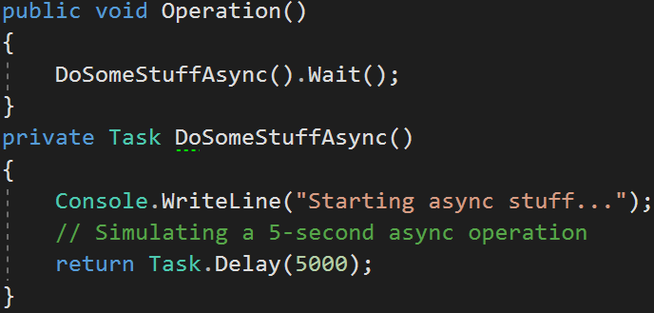
Consider the following code…
What actually happens when you call the Operation method?
Could this be written better?
The first Console.WriteLine is called, then Task.Delay is called. Task.Delay returns an incomplete task.
Execution of Operation then continues until the call to the Wait method. The Wait method tells the thread it needs to wait for the task from DoSomeStuffAsync to complete. The thread is blocked and can’t do anything else until the task is complete.
Eventually the Task.Delay task is complete, so DoSomeStuffAsync is completed, which means the thread is no longer blocked and can now finish execution of the Operation method. The thread is blocked for almost all of this scenario.

Slide 17
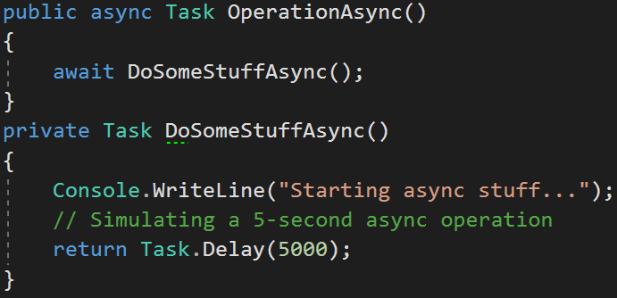
Consider this code instead…
What happens when you call the OperationAsync method?
Why is this better?
The first Console.WriteLine is called, then Task.Delay is called. Task.Delay returns an incomplete task.
Execution of OperationAsync then continues until the call to the await keyword. The await keyword tells the thread that we need to wait for DoSomeStuffAsync to complete before continuing, and schedules the rest of the method to be completed by any thread from the thread pool. The thread is therefore not blocked and is free to do other work.
Eventually the Task.Delay task is complete, so DoSomeStuffAsync is completed, which means the rest of OperationAsync can now be completed by a thread from the thread pool. No threads were blocked in this entire scenario.

Slide 18
Summary
The following are synchronous (blocking) ways of waiting for tasks to complete and should be avoided when possible:
Wait() – Waits for the task to complete execution
Result – Waits for the task to complete execution and then returns the result value.
You want to use async and await instead, whenever possible
Let’s see what else we can do with this keywords

Slide 19
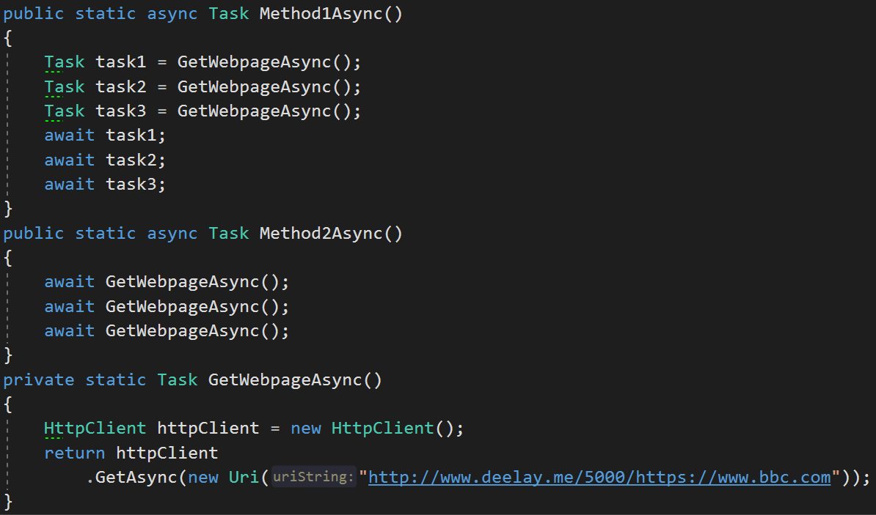
Consider the following code…
Which of these methods has the fastest performance?
A. Method1Async
B. Method2Async

Slide 20
Consider the following code…
The answer is A
Method1Async is considerably faster than Method2Async

Slide 21
Consider the following code…
Method1Async
task1, task2 and task3 are started
Execution of Method1Async continues until the “await task1” line, where execution pauses until task1 is complete. The thread that was executing Method1Async can then continue other scheduled work.
During this time, all 3 tasks run asynchronously. This means that once task1 is complete, either task2 and task3 are already complete, or we have to wait a much shorter amount of time for them to complete.
Execution only takes as long as the longest running task.
This is always the fastest way to write async/await code

Slide 22
Consider the following code…
Method2Async
The first call to GetWebpageAsync is started and then immediately awaited.
After that task is completed, the next call to GetWebpageAsync is started and immediately awaited.
After the second task is completed, the third one is started and immediately awaited.
Each task is only started after the previous task is completed.
Execution takes as long as 3 sequential GetWebpageAsync calls. This will always be slower than running the tasks concurrently.
This is always the slowest way to write async/await code

Slide 23
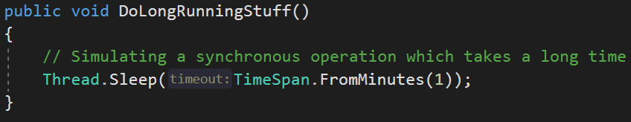

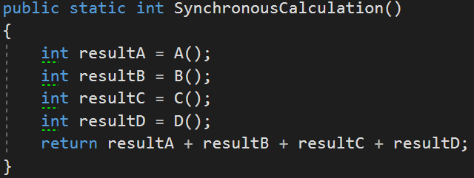
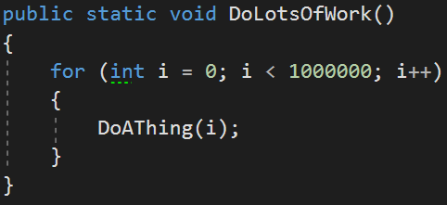
Here are some example of synchronous operations in C#:

Slide 24
When tasks throw exceptions…
Observing the completion of a failed task by using Wait(), Result, await or GetAwaiter().GetResult() will propagate its exception to where you’re waiting for the task to complete. At this point, you need to handle it with a try/catch block.
As a task needs to keep track of exceptions thrown in subtasks, any thrown exceptions are grouped as a single AggregateException. You need to then inspect the inner exceptions to determine the underlying cause of the issue. This can lead to ugly unwrapping logic when catching exceptions.
Exceptions thrown within a task are always accessible from the Exception property. This is of type AggregateException.
Using await or GetAwaiter().GetResult() will not throw an AggregateException. It will instead propagate the first exception which was thrown, just like when writing synchronous code.
If you absolutely must wait synchronously, use GetAwaiter().GetResult(). Otherwise, use await!
Ideally, you should never have to worry about AggregateExceptions!

Slide 25
async void

Slide 26
The dangers of async void
NOTES:
Before .NET 4.5:
When not using async void and an unobserved exception is thrown, the garbage collector will trigger the UnobservedTaskException event on the TaskScheduler, which by default will completely terminate your process. By default nowadays it won’t terminate your process and will instead be ignored. This default behaviour can be overridden however.
With async void, the exception will still terminate your process.
async void should only be used for top-level methods. Any unobserved exceptions thrown in those will be ignored and are fine.

Slide 27
Task.Run
Task.Start
Task.Wait
Task.RunSynchronously
Use Task.Delay instead of Thread.Sleep as it’s asynchronous

Slide 28
Here’s an analogy…
You’re in your kitchen at home, making a pasta dish and a dessert.
The steps are simple:
Heat a saucepan of water until it starts boiling (takes 5 mins)
Cook fresh pasta (5 mins)
Drain the water from the pasta (1 min)
Place pasta in a dish and add sauce (1 min)
Grate cheese (2 mins)
Add cheese to pasta (1 min)
Pre-heat oven to 200°C (15 mins)
Place dish in oven and bake (15 mins)
Prepare the dessert (20 mins)

Slide 29
Some steps are performed by a person, others aren’t
Green steps are ones which are completed by yourself
Orange steps are ones which are out of your control once started
Heat a saucepan of water until it starts boiling (5 mins)
Cook fresh pasta (5 mins)
Drain the water from the pasta (1 min)
Place pasta in a dish and add sauce (1 min)
Grate cheese (2 mins)
Add cheese to pasta (1 min)
Pre-heat oven to 200°C (15 mins)
Place dish in oven and bake (15 mins)
Prepare the dessert (20 mins)

Slide 30
Synchronously, this takes a really long time
Executing these steps synchronously would mean not continuing onto the next step until the current step is complete. That means you wait for 5 minutes doing nothing while waiting for the water, instead of doing something else which doesn’t depend on it (i.e. grating cheese for later). It also means waiting for 15 minutes doing nothing while waiting for the oven to pre-heat.
Heat a saucepan of water until it starts boiling (5 mins)
Cook fresh pasta (5 mins)
Drain the water from the pasta (1 min)
Place pasta in a dish and add sauce (1 min)
Grate cheese (2 mins)
Add cheese to pasta (1 min)
Pre-heat oven to 200°C (15 mins)
Place dish in oven and bake (15 mins)
Prepare the dessert (20 mins)
Total time taken is 65 minutes. Far too long!

Slide 31
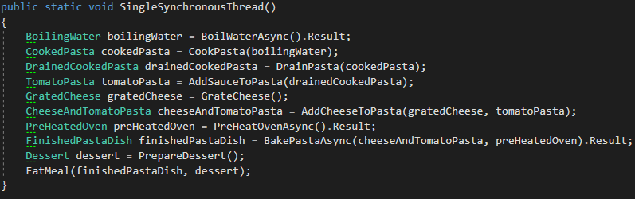
C# code

Slide 32
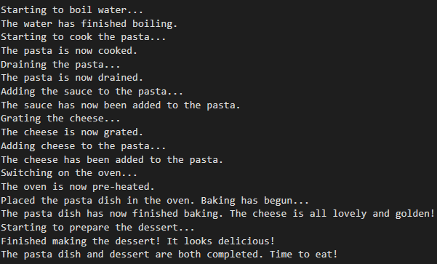
Console output (it’s ridiculous)

Slide 33
Asynchronously, this takes a lot less time
Let’s introduce the concept of starting a task which will complete by itself, then continuing with other work until we need the result of that task.
Start heating a saucepan of water
Switch on oven so it can pre-heat
Grate cheese (2 mins)
Wait for the water to finish boiling (3 mins)
Cook fresh pasta (5 mins) requires boiling water
Drain the water from the pasta (1 min)
Place pasta in a dish and add sauce (1 min)
Add cheese to pasta (1 min)
Wait for the oven to finish pre-heating (2 mins)
Put dish in oven and start baking requires pre-heated oven
Prepare the dessert (20 mins)
Retrieve finished pasta from oven (0 mins)
Total time taken is 35 minutes. We saved 30 minutes just from doing things asynchronously!

Slide 34
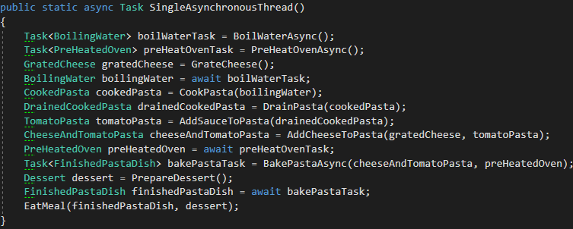
C# code

Slide 35
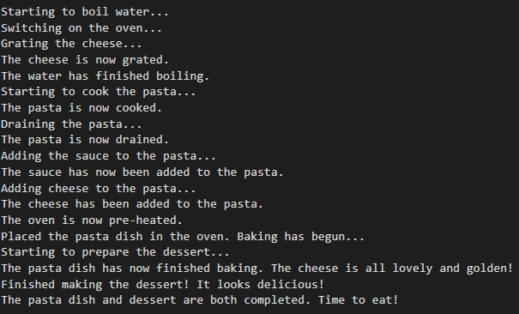
Console output (much better!)

Slide 36
How does multithreading fit into this?

Slide 37
What about synchronously with multiple threads? (other people cooking)
If other people help you cook, but you all perform synchronously, it helps a lot.
Thread 1 Heat a saucepan of water until it starts boiling (5 mins) Cook fresh pasta (5 mins) Drain the water from the pasta (1 min) Place pasta in a dish and add sauce (1 min) Wait for thread 4 to finished grating cheese (0 mins) Add cheese to pasta (1 min) Wait for thread 2 to finished pre-heating oven (0 mins) Place dish in oven and bake (15 mins) Wait for thread 3 to finish dessert (0 mins) Time taken for thread 1: 28 mins | Thread 2 Pre-heat oven to 200°C (15 mins) Time taken for thread 2: 15 mins | Thread 3 Prepare the dessert (20 mins) Time taken for thread 3: 20 mins | Thread 4 Grate cheese (2 mins) Time taken for thread 4: 2 mins
The total time taken is 28 mins, as that’s how long the longest running thread takes. We’ve saved 37 minutes!
Thread 2 doesn’t do much. It starts to pre-heat the oven, then waits 15 minutes. This is not good use of resources.
Thread 3 prepares the dessert, as it’s a major “CPU-bound” step it can do in parallel to Threads 1 and 4.
Thread 4 only grates the cheese, a minor CPU-bound task which it complete in parallel to Threads 1 and 3.
Compared to using a single asynchronous thread, we’ve saved 7 minutes, or 1/5th of the time. At a huge cost though!

Slide 38
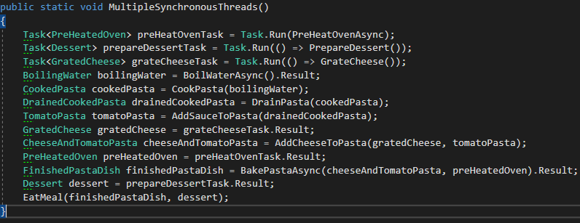
C# code

Slide 39
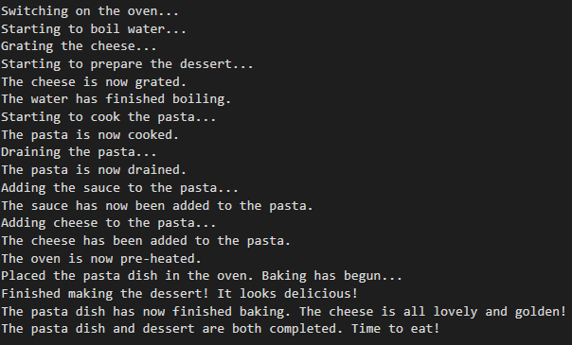
Console output

Slide 40
What about asynchronously with multiple threads?
If other people help you cook, and you all perform asynchronously, it helps a lot more.
Thread 1 Start heating a saucepan of water Start pre-heating oven Wait for the water to finish boiling (3 mins) Cook fresh pasta (5 mins) Drain the water from the pasta (1 min) Place pasta in a dish and add sauce (1 min) Add cheese to pasta (1 min) Wait for thread 2 to finished pre-heating oven (2 mins) Place dish in oven and bake Wait for the pasta to finish baking (15 mins) Wait for thread 2 to finish dessert (0 mins) Time taken for thread 1: 28 mins | Thread 2 Prepare the dessert (20 mins) Time taken for thread 2: 20 mins | Thread 3 Grate cheese (2 mins) Time taken for thread 3: 2 mins
The total time taken is 28 mins. We’re still saving 37 mins, like synchronous multithreading.
Thread 4 is no longer needed. We can now accomplish the same amount of work, in the same time, using just 3 threads.
This is considerably better for us as it uses less resources. Thread 4 could now be potentially used for a different task.

Slide 41
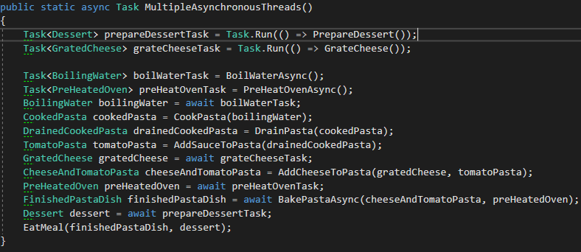
C# code

Slide 42
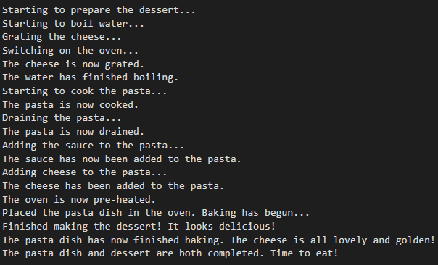
Console output

Slide 43
Back to what was said about synchronous and asynchronous operations…
Synchronous code may or may not run in the same thread.
We have seen how you can cook synchronously alone or with someone else (another thread).
Synchronous operations can be performed sequentially, or simultaneously.
Cooking the pasta, draining it, adding sauce, etc. are performed sequentially.
Preparing the dessert could be performed simultaneously with the pasta.
Asynchronous operations may or may not run in multiple threads.
We have demonstrated that you can cook asynchronously alone or with someone else.
Asynchronous operations can be just scheduled but never guaranteed to run at a certain time.
In reality you might decide to switch on the oven before starting to heat the saucepan of water, or the other way around. It would probably depend on which task can be started quickest, depending on where you are in your kitchen. There’s no real guarantee that one task will be started before the other and it doesn’t really matter. All that matters is that they are scheduled to be started as soon as possible and will be finished later on.

Slide 44
Some easy rules to follow for some common questions
Should I be using multiple threads?
If there is a performance bottleneck caused by CPU-bound work which can be run in parallel, go for it, unless you’re using building a web application (more on this later).
If the performance bottleneck isn’t CPU-bound (i.e. disk I/O, network I/O) or it’s CPU-bound and can’t be run in parallel, there is no benefit and it can be detrimental to performance/resource usage.
Should I be using asynchronous code?
Ideally you should use it everywhere you’re dealing with high-latency, non-CPU-bound tasks (i.e. disk I/O, network I/O). CPU-bound work shouldn’t be async as there’s no point.
Methods with names such as DownloadStringAsync implies there is some form of network I/O which can be run asynchronously.
Should I be using synchronous code?
For CPU-bound work, yes. For non-CPU-bound work, no.
C# Methods such as Math.Sqrt wouldn’t make much sense as Math.SqrtAsync.

Slide 45
It’s really about finding a compromise between performance and scalability
Performance
A measure of how fast an operation can be completed.
Throughput
A measure of the number of operations which can be completed in a given amount of time.
Efficiency
A measure of an operation’s resource usage.
Scalability
A measure of how readily a system, network, or process can handle a growing amount of work, or its potential to be enlarged to accommodate that growth.
A system is considered scalable if it is capable of increasing its throughput under an increased load when resources (typically hardware) are added
So going back to our kitchen analogy, we already know the performance is vastly improved by using asynchronous operations and multithreading. But what about scalability?

Slide 46
Scheduling | Resources (threads) | Time taken (minutes) | Throughput (meals/hr) | Efficiency (Throughput/Resources) | Performance Rating (1-4) | Scalability Rating (1-4) | Overall Rating
Asynchronous | 3 | 28 | 2.14 | 0.71 | 1 | 3 | 2
Synchronous | 4 | 28 | 2.14 | 0.54 | 1 | 4 | 3
Asynchronous | 1 | 35 | 1.71 | 1.71 | 2 | 1 | 1
Synchronous | 1 | 65 | 0.92 | 0.92 | 3 | 2 | 3
What do we know from these results?
If you want a balance between performance and scalability, use a single asynchronous thread. This is the cheapest solution for scaling for large demand, whilst offering performance benefits. Ideal for a web application.
If you want the greatest performance and don’t need to worry about scalability, you can also go for multiple asynchronous threads. This is ideal for native applications such as a desktop or mobile application.
You should avoid synchronous scheduling when possible as it blocks threads.
If you are forced to use synchronous scheduling, it’s best to use multiple threads but only if you have the resources available on the platform you’re running the application on.

Slide 47

How to use multiple threads
Use Task.Run(someAction) to queue a task to run on a new thread, instead of Task.Factory.StartNew
Queueing a task to run on a new thread is easy…but should you really be doing it?

Slide 48
Desktop and mobile applications love multithreading
Applications like this only have one user at a time. As a result, you can essentially throw threads at a problem in order to provide the best performance. This particular user having the best performance won’t affect other users.
Horizontal scaling (running the application across multiple devices) is not a concept which applies here. The user is only using a single device (i.e. their mobile phone).
Vertical scaling (providing greater performance when given a more powerful device) applies but isn’t going to happen unless the user themselves physically switches to a better machine. It isn’t an area to focus on. Writing your code so you use threads efficiently is advised but not critical.

Slide 49
Multithreading can kill your web application
Web applications (e.g. ASP.NET MVC / WebAPI project) need to respond to HTTP requests. Each HTTP request requires its own thread from the thread pool. As a result, you should preserve your thread pool threads for handling requests. Using too many threads for improving performance for a single user would mean less users can be served on the same instance of your application.
Horizontal scaling is critical to web applications. Each node in your cluster must be able to respond to as many requests as possible. Efficient use of threads will mean more users can use the application deployed on each node.
Vertical scaling is expensive so you must make sure you serve the most requests possible out of your new and more expensive hardware.
But what if you want to execute an asynchronous task without waiting for it to finish?

Slide 50
The problem with background (“fire and forget”) tasks in ASP.NET / ASP.NET Core
Web applications run on a server within an application pool (a way of segregating applications for security and allowing different configurations and resource usages for each one)
Each application pool corresponds to a single worker process. This is a process responsible for handling requests sent to a server for a specific application pool.
Each worker process is periodically terminated and a new process is started. This is called Application Pool Recycling and is done to avoid unstable states that can lead to application crashes, memory leaks, etc.
An overlapping recycle method is used, which keeps the old process up until the current requests are finished processing (or a set timeout elapses) while the new process handles new requests. This ensures service continuity so that you usually do not notice a recycle.
Creating new threads manually, either on the Thread Pool or not, will not be registered with the runtime, so the application pool may be recycled before these background tasks are complete.

Slide 51

The solution
ASP.NET has the HostingEnvironment.QueueBackgroundWorkItem method. From MSDN:
Remarks
Differs from a normal ThreadPool work item in that ASP.NET can keep track of how many work items registered through this API are currently running, and the ASP.NET runtime will try to delay AppDomain shutdown until these work items have finished executing. This API cannot be called outside of an ASP.NET-managed AppDomain. The provided CancellationToken will be signaled when the application is shutting down.
QueueBackgroundWorkItem takes a Task-returning callback; the work item will be considered finished when the callback returns.

Slide 52
The solution
In ASP.NET Core, background tasks can be implemented as hosted services. A hosted service is a class with background task logic that implements the IHostedService interface. You can host things such as:
Background tasks that run on a timer.
Hosted service that activates a scoped service. The scoped service can use dependency injection.
Queued background tasks that run sequentially.
The hosted service is activated once at app startup and gracefully shut down at app shutdown. If an error is thrown during background task execution, Dispose should be called even if StopAsync isn't called.
Fairly simply to implement and Microsoft has excellent documentation on it: https://docs.microsoft.com/en-us/aspnet/core/fundamentals/host/hosted-services?view=aspnetcore-2.1#queued-background-tasks

Slide 53
The solution
Other solutions include:
Using a library like Hangfire which has a persistence layer for storing your tasks to be executed reliably.
Using Azure Service Fabric actors to do this work instead.
Using some other way of persisting the tasks in some way to a queue and processing them with a different system. E.g. using an Azure Storage Queue to store messages temporarily, then using an Azure Function to process messages in order from the queue.

Slide 54
Multithreading can kill your Azure Service Fabric actors
From the the MSDN page for Service Fabric Reliable Actors:
“The Reliable Actors API provides a single-threaded programming model built on the scalability and reliability guarantees provided by Service Fabric.”
“An actor is an isolated, independent unit of compute and state with single-threaded execution.”
Actors are activated on a thread when a request is made to them.
An actor is deactivated and garbage collected when it hasn’t been used in some time. “Using” an actor involves either making a request or a reminder has been triggered.
Creating another thread within the then means there is one less thread available to activate another actor. The actor runtime also has no knowledge of this thread. Not waiting for it to finish (fire and forget) is dangerous as the actor can be deactivated and even moved to another node, so your other thread can be killed without warning.

Slide 55
The solution
Here are some alternatives to using multiple threads in your actors:
Split the work amongst multiple actors. It’s worth remembering as well that an actor can create and communicate with other actors.
Add a message to a queue to be processed by some other service.
Why not just get the actor to do all the long-running work anyway? If it’s a fire-and-forget task where performance isn’t a factor, you might as well just run it for as long as it needs to run. If performance is an issue, then consider another option.

Slide 56
Dealing with exceptions

Slide 57
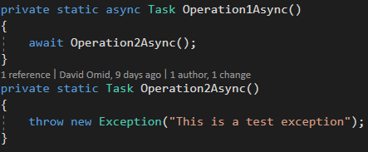
Given the following methods…
Operation1Async just awaits a task which throws an exception.
There is more than way of executing Operation1Async and each way might have different behaviours.

Slide 58
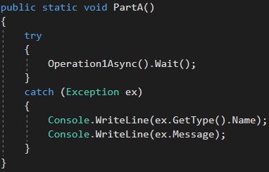
Question A
What will be the output of this method?
AggregateException One or more errors occurred. (This is a test exception)
Exception
This is a test exception
An uncaught exception is thrown and can be caught in the calling method
None of the above.

Slide 59
Question A
The answer is
AggregateException One or more errors occurred. (This is a test exception)

Slide 60
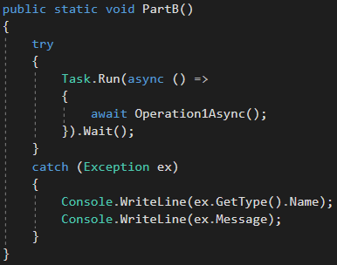
Question B
What will be the output of this method?
AggregateException One or more errors occurred. (This is a test exception)
Exception
This is a test exception
An uncaught exception is thrown and can be caught in the calling method
None of the above.

Slide 61
Question B
The answer is
AggregateException One or more errors occurred. (This is a test exception)

Slide 62
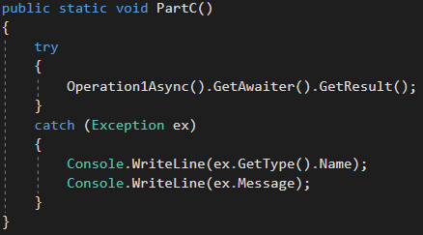
Question C
What will be the output of this method?
AggregateException One or more errors occurred. (This is a test exception)
Exception
This is a test exception
An uncaught exception is thrown and can be caught in the calling method
None of the above.

Slide 63
Question C
The answer is
B. Exception
This is a test exception

Slide 64
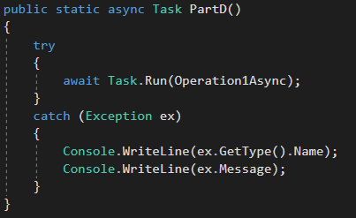
Question D
What will be the output of this method?
AggregateException One or more errors occurred. (This is a test exception)
Exception
This is a test exception
An uncaught exception is thrown and can be caught in the calling method
None of the above.

Slide 65
Question D
The answer is
B. Exception
This is a test exception

Slide 66
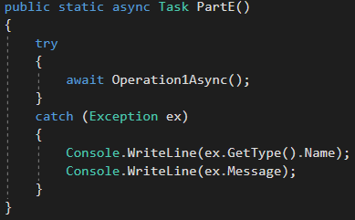
Question E
What will be the output of this method?
AggregateException One or more errors occurred. (This is a test exception)
Exception
This is a test exception
An uncaught exception is thrown and can be caught in the calling method
None of the above.

Slide 67
Question E
The answer is
B. Exception
This is a test exception

Slide 68

Question F
What will be the output of this method?
AggregateException One or more errors occurred. (This is a test exception)
Exception
This is a test exception
An uncaught exception is thrown and can be caught in the calling method
None of the above.

Slide 69
Question F
The answer is
D. None of the above.
It will completely terminate the process. It won't throw a visible exception and will completely kill the application/debugger.

Slide 70

Question G
What will be the output of this method?
AggregateException One or more errors occurred. (This is a test exception)
Exception
This is a test exception
An uncaught exception is thrown and can be caught in the calling method
None of the above.

Slide 71
Question G
What will be the output of this method?
An uncaught exception is thrown and can be caught in the calling method
It will throw the following uncaught exception:
Exception
This is a test exception

Slide 72
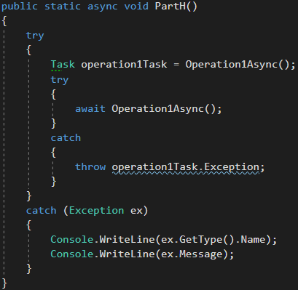
Question H
What will be the output of this method?
AggregateException One or more errors occurred. (This is a test exception)
Exception
This is a test exception
An uncaught exception is thrown and can be caught in the calling method
None of the above.

Slide 73
Question H
The answer is
AggregateException One or more errors occurred. (This is a test exception)

Slide 74

Question I
What will be the output of this method?
AggregateException One or more errors occurred. (This is a test exception)
Exception
This is a test exception
An uncaught exception is thrown and can be caught in the calling method
None of the above.

Slide 75
Question I
The answer is
D. None of the above.
There is no output as the exception of the task is never observed.

